Slide 1
Functional Dependencies & Normalization

Slide 2
Stages of Normalisation
Unnormalised
(UDF)
Remove repeating groups
First normal form
(1NF)
Remove partial dependencies
Second normal form
(2NF)
Remove transitive dependencies
Third normal form
(3NF)

Slide 3
Example 2: University Database Table
StdSSN → StdCity, StdClass
OfferNo → OffTerm, OffYear, CourseNo, CrsDesc
CourseNo → CrsDesc
StdSSN, OfferNo → EnrGrade
Notes:
Big University Database Table:
- Table 7-1 except for omission of two columns (StdCity and OffTerm)

Slide 4
Problems
Anomalies:
- PK: combination of StdSSN and OfferNo
- Insert: cannot insert a new student without enrolling in an offering (OfferNo part of PK)
- Update: change a course description; change every enrollment of the course
- Delete: remove third row; lose information about course C3
Table has obvious redundancies
Easier to query: no joins
More difficult to change: can work around problems (dummy PK) but tedious to do

Slide 5
FD Diagrams and Lists
StdSSN → StdCity, StdClass
OfferNo → OffTerm, OffYear, CourseNo, CrsDesc
CourseNo → CrsDesc
StdSSN, OfferNo → EnrGrade
Notes:
FD diagram:
- 8.2 of textbook chapter 8
- See related FDs (same LHS) by line height
- Useful for small sets of FDs
- Unwieldy for large sets of FDs
FD list:
- Group by LHS
- Shortcut notation: X -> Y, Z is a shortcut for X -> Y and X -> Z
Compound LHS:
- Similar to a combined PK
- Compound LHS is not a shortcut (as is a compound RHS)
- Combination of StdSSN and OfferNo determine EnrGrade (not either column alone)
Minimality:
- LHS must be minimal
- Cannot remove columns from LHS without making the FD invalid
- Usually non minimal LHS is not a problem: important that LHS does not have
extraneous columns
- Properly known as full functional dependence: minimal LHS makes full functional dep.

Slide 6
Normalization
Process of removing unwanted redundancies
Apply normal forms
Identify FDs
Determine whether FDs meet normal form
Split the table to meet the normal form if there is a violation
Notes:
Normal form:
- Rule about allowable pattern of FDs (1NF through BCNF)
- Higher normal forms are not rules about FDs: more difficult to understand and use
- Most important part is to record FDs: CASE tool can perform normalization
- Check FDs to see if they violate the pattern permitted in the normal form
Split table
- Smaller tables do not violate the normal form
- Smaller tables should not lose information contained in the larger table
Difficulty:
- Normalization is easy to apply to small tables with simple dependency structures
- Use CASE tool for large databases and tables with complex dependency structures

Slide 7
1NF
No repeating groups: flat rows
Notes:
Big university database table is not normalized
- Not in 1NF
- S1 row has repeating values (O1 and O2)
- S2 row has repeating values (O3 and O2)
Convert to 1NF:
- Flatten rows
- Split each repeating group into a separate row
- Repeat the implied values in the new rows:
- S1 JUN for row two with O2 2000 3.3 C2 VB
- S2 JUN for row four with O2 2000 3.4 C2 VB

Slide 8
Combined Definition of 2NF/3NF
Key column: candidate key or part of candidate key
Analogy to the traditional justice oath
Every non key depends on a key, the whole key, and nothing but the key
Usually taught as separate definitions
Notes:
There should be no partial dependencies
Candidate key:
- Unique
- Minimal: no extraneous columns without losing uniqueness property
- Can have multiple candidate keys per table
Key column:
- A candidate key by itself
- Part of a combined CK
- Nonkey: a column that is not a key column
Combined definition:
- Analogy to traditional justice oath
- So help me: Ted Codd (father of relational databases)
- Usually taught as separate definitions for simplicity

Slide 9
2NF
Every nonkey column depends on a whole key, not part of a key
Violations
Part of key → nonkey
Violations only for combined keys
Notes:
There should be no partial dependencies
First of combined 2NF/3NF definition: dependent on the whole key
Violation:
- Part of a key determines a non key
- If FDs for a table contain such an FD, split the table

Slide 10
2NF Example
Many violations for the big university database table
StdSSN → StdCity, StdClass
OfferNo → OffTerm, OffYear, CourseNo, CrsDesc
Splitting the table
UnivTable1 (StdSSN, StdCity, StdClass)
UnivTable2 (OfferNo, OffTerm, OffYear, CourseNo, CrsDesc)
Notes:
Violating FDs:
- All FDs violate except StdSSN, OfferNo -> EnrGrade
- StdSSN: part of a key (not the entire key)
- OfferNo: part of a key (not the entire key)
Splitting:
- Place each FD group in a separate table
- UnivTable1: StdSSN group
- UnivTable2: OfferNo group
- UnivTable3: StdSSN, OfferNo group
- No violations among new tables
- CourseNo -> CrsDesc (CourseNo is not part of a key)
- This FD violates 3NF, not 2NF
Splitting process:
- Recover original table with natural join
- Not lose any FDs: all FDs are derivable
- Books on normalization theory explain criteria: theory not important here

Slide 11
3NF
Every nonkey column depends only on a key not on non key columns
Violations: Nonkey → Nonkey
Alterative formulation
No transitive FDs
A → B, B → C then A → C
OfferNo → CourseNo, CourseNo → CrsDesc then OfferNo → CrsDesc
Notes:
Second part of combined 2NF/3NF definition: nothing but the key
B depends on Key A, C depends in B (non key) then C depends on A. C can be null in B→C then A cannot be determine
Violation:
- Non key determines a non key
- If FDs for a table contain such an FD, split the table
Alternative formulation:
- No transitive FDs
- Law of transitivity: A < B, B < C then A < C
- Transitivity applies to FDs
- Not the preferred definition of 3NF: should not write down transitively derived FDs
- Simple synthesis procedure for BCNF

Slide 12
3NF Example
One violation in UnivTable2
CourseNo → CrsDesc
Splitting the table
UnivTable2-1 (OfferNo, OffTerm, OffYear, CourseNo)
UnivTable2-2 (CourseNo, CrsDesc)
Notes:
Violating FDs:
- CourseNo is non key
- Alternatively, OfferNo -> CrsDesc is a transitively derived FD
Splitting UnivTable2:
- Arrange by LHS
- UnivTable2-2: CourseNo is the PK

Slide 13
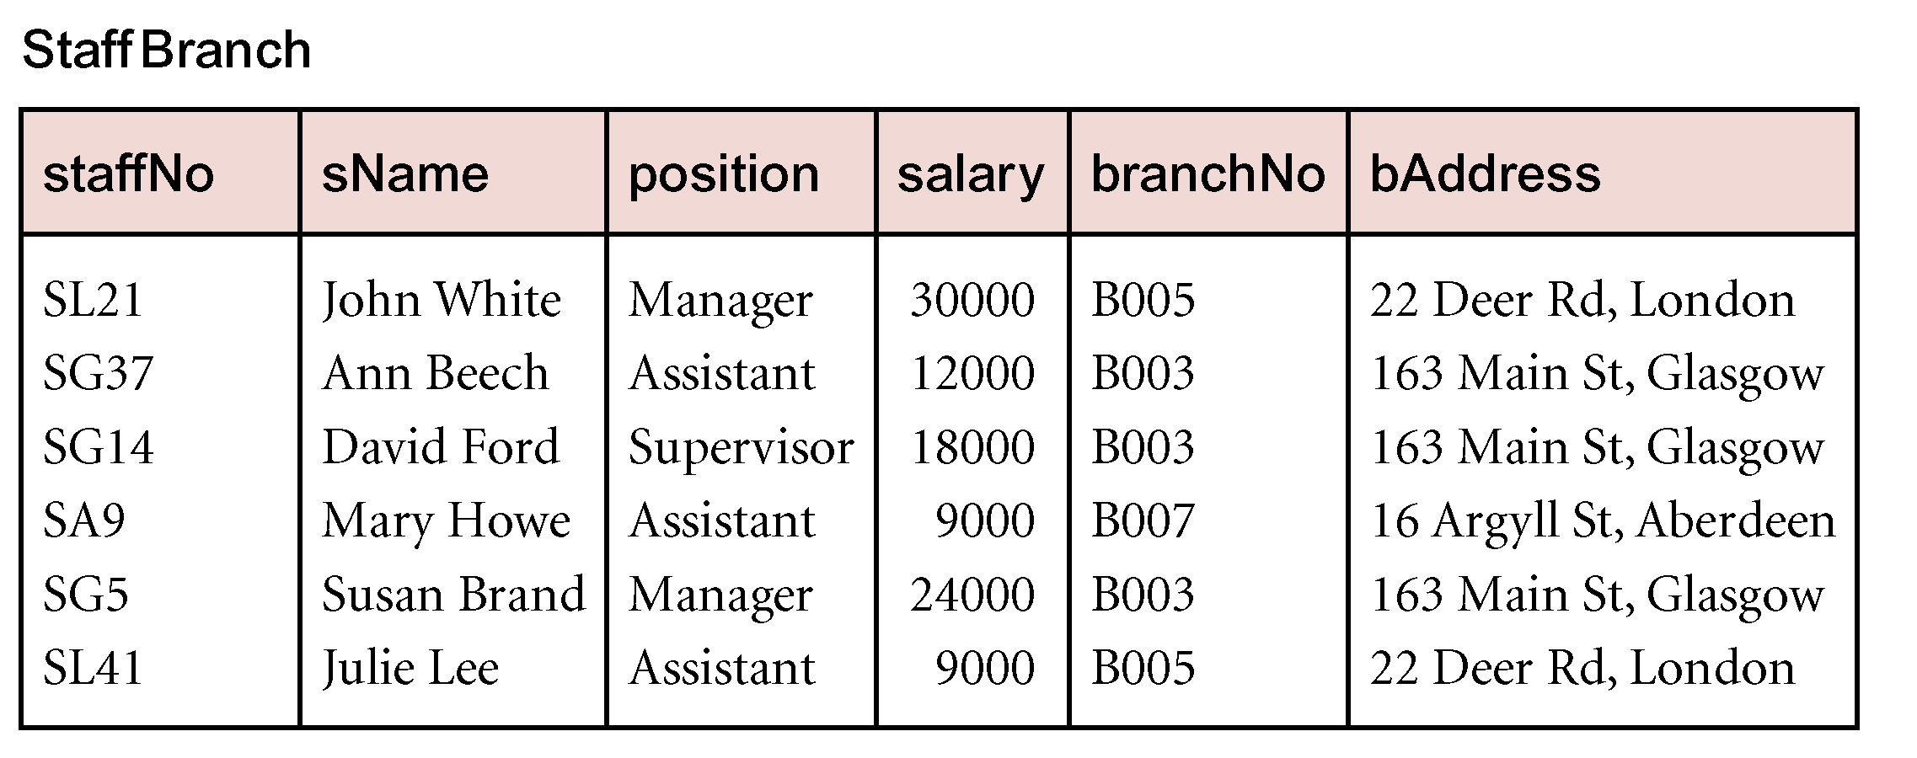
Example 2
Notes:
13

Slide 14
Unnormalised Normal Form (UNF)
ORDER (order-no, order-date, cust-no, cust-name, cust-add,
(prod-no, prod-desc, unit-price, ord-qty, line-total)*, order-total

Slide 15
First Normal Form (1NF)
Definition: A relation is in 1NF if, and only if, all its underlying attributes contain atomic values only.
Remove repeating groups into a new relation
A repeating group is shown by a pair of brackets within the relational schema.
ORDER (order-no, order-date, cust-no, cust-name, cust-add,
(prod-no, prod-desc, unit-price, ord-qty, line-total)*, order-total

Slide 16
Steps from UNF to 1NF:
Remove the outermost repeating group (and any nested repeated groups it may contain) and create a new relation to contain it.
Add to this relation a copy of the PK of the relation immediately enclosing it.
Name the new entity (appending the number 1 to indicate 1NF)
Determine the PK of the new entity
Repeat steps until no more repeating groups.

Slide 17
Example - UNF to 1NF
ORDER (order-no, order-date, cust-no, cust-name, cust-add,
(prod-no, prod-desc, unit-price, ord-qty, line-total)*, order-total
1. Remove the outermost repeating group (and any nested repeated groups it may contain) and create a new relation to contain it. (rename original to indicate 1NF)
ORDER-1 (order-no, order-date, cust-no, cust-name, cust-add, order-total
(prod-no, prod-desc, unit-price, ord-qty, line-total)
2. Add to this relation a copy of the PK of the relation immediately enclosing it.
ORDER-1 (order-no, order-date, cust-no, cust-name, cust-add, order-total
(order-no, prod-no, prod-desc, unit-price, ord-qty, line-total)
3. Name the new entity (appending the number 1 to indicate 1NF)
ORDER-LINE-1 (order-no, prod-no, prod-desc, unit-price, ord-qty, line-total)
4. Determine the PK of the new entity
ORDER-LINE-1 (order-no, prod-no, prod-desc, unit-price, ord-qty, line-total)

Slide 18
Second Normal Form (2NF)
Definition: A relation is in 2NF if, and only if, it is in 1NF and every non-key attribute is fully dependent on the primary key.
Remove partial functional dependencies into a new relation

Slide 19
Steps from 1NF to 2NF:
Remove the offending attributes that are only partially functionally dependent on the composite key, and place them in a new relation.
Add to this relation a copy of the attribute(s) which are the determinants of these offending attributes. These will automatically become the primary key of this new relation.
Name the new entity (appending the number 2 to indicate 2NF)
Rename the original entity (ending with a 2 to indicate 2NF)

Slide 20
Example - 1NF to 2NF
ORDER-LINE-1 (order-no, prod-no, prod-desc, unit-price, ord-qty, line-total)
1. Remove the offending attributes that are only partially functionally dependent on the composite key, and place them in a new relation.
ORDER-LINE-1 (order-no, prod-no, ord-qty, line-total)
(prod-desc, unit-price)
2. Add to this relation a copy of the attribute(s) which determines these offending attributes. These will automatically become the primary key of this new relation..
ORDER-LINE-1 (order-no, prod-no, ord-qty, line-total)
(prod-no, prod-desc, unit-price)
3. Name the new entity (appending the number 2 to indicate 2NF)
PRODUCT-2 (prod-no, prod-desc, unit-price)
4. Rename the original entity (ending with a 2 to indicate 2NF)
ORDER-LINE-2 (order-no, prod-no, ord-qty, line-total)

Slide 21
Third Normal Form (3NF)
Definition: A relation is in 3NF if, and only if, it is in 2NF and every non-key attribute is non-transitively dependent on the primary key.
Remove transitive dependencies into a new relation

Slide 22
Steps from 2NF to 3NF:
Remove the offending attributes that are transitively dependent on non-key attribute(s), and place them in a new relation.
Add to this relation a copy of the attribute(s) which are the determinants of these offending attributes. These will automatically become the primary key of this new relation.
Name the new entity (appending the number 3 to indicate 3NF)
Rename the original entity (ending with a 3 to indicate 3NF)

Slide 23
Example - 2NF to 3NF
ORDER-2 (order-no, order-date, cust-no, cust-name, cust-add, order-total
1. Remove the offending attributes that are transitively dependent on non-key attributes, and place them in a new relation.
ORDER-2 (order-no, order-date, cust-no, order-total
(cust-name, cust-add )
2. Add to this relation a copy of the attribute(s) which determines these offending attributes. These will automatically become the primary key of this new relation..
ORDER-2 (order-no, order-date, cust-no, order-total
(cust-no, cust-name, cust-add )
3. Name the new entity (appending the number 3 to indicate 3NF)
CUSTOMER-3 (cust-no, cust-name, cust-add )
4. Rename the original entity (ending with a 3 to indicate 3NF)
ORDER-3 (order-no, order-date, cust-no, order-total

Slide 24
Example - Relations in 3NF
ORDER-3 (order-no, order-date, cust-no, order-total
CUSTOMER-3 (cust-no, cust-name, cust-add )
PRODUCT-2 (prod-no, prod-desc, unit-price)
ORDER-LINE-2 (order-no, prod-no, ord-qty, line-total)
prod-no
order-no
PRODUCT
ORDER
places
contains
shows
placed by
belongs to
cust-no
order-no, prod-no
CUSTOMER
part of
ORDER-LINE

Slide 25
What is de-Normalization?
Denormalization is a strategy used on a previously-normalized database to increase performance. In computing, denormalization is the process of trying to improve the read performance of a database, at the expense of losing some write performance, by adding redundant copies of data or by grouping data. It is often motivated by performance or scalability in relational database software needing to carry out very large numbers of read operations. Denormalization should not be confused with Unnormalized form. Databases/tables must first be normalized to efficiently denormalize them.
Apply de-normalization: separate the logically related attributes into tables to minimize redundancy

Slide 26
Additional Slides

Slide 27
1st Normal Form (1NF)
Lecture 5 > Section 1 > Overview
Student | Courses
Mary | {CS145,CS229}
Joe | {CS145,CS106}
… | …
Student | Courses
Mary | CS145
Mary | CS229
Joe | CS145
Joe | CS106
Violates 1NF.
In 1st NF
1NF Constraint: Types must be atomic!

Slide 28
Data Anomalies & Constraints
Lecture 5 > Section 1 > Data anomalies & constraints

Slide 29
Constraints Prevent (some) Anomalies in the Data
Lecture 5 > Section 1 > Data anomalies & constraints
A poorly designed database causes anomalies:
Student | Course | Room
Mary | CS145 | B01
Joe | CS145 | B01
Sam | CS145 | B01
.. | .. | ..
If every course is in only one room, contains redundant information!

Slide 30
Constraints Prevent (some) Anomalies in the Data
Lecture 5 > Section 1 > Data anomalies & constraints
A poorly designed database causes anomalies:
Student | Course | Room
Mary | CS145 | B01
Joe | CS145 | C12
Sam | CS145 | B01
.. | .. | ..
If we update the room number for one tuple, we get inconsistent data = an update anomaly

Slide 31
Constraints Prevent (some) Anomalies in the Data
Lecture 5 > Section 1 > Data anomalies & constraints
A poorly designed database causes anomalies:
Student | Course | Room
.. | .. | ..
If everyone drops the class, we lose what room the class is in! = a delete anomaly

Slide 32
Constraints Prevent (some) Anomalies in the Data
Lecture 5 > Section 1 > Data anomalies & constraints
A poorly designed database causes anomalies:
Similarly, we can’t reserve a room without students = an insert anomaly
Student | Course | Room
Mary | CS145 | B01
Joe | CS145 | B01
Sam | CS145 | B01
.. | .. | ..
… | CS229 | C12

Slide 33
Constraints Prevent (some) Anomalies in the Data
Lecture 5 > Section 1 > Data anomalies & constraints
Is this form better?
Redundancy?
Update anomaly?
Delete anomaly?
Insert anomaly?
Student | Course
Mary | CS145
Joe | CS145
Sam | CS145
.. | ..
Course | Room
CS145 | B01
CS229 | C12
Today: develop theory to understand why this design may be better and how to find this decomposition…

Slide 34
FDs for Relational Schema Design
Lecture 5 > Section 1 > Functional dependencies
High-level idea: why do we care about FDs?
Start with some relational schema
Find out its functional dependencies (FDs)
Use these to design a better schema
One which minimizes the possibility of anomalies

Slide 35
Functional Dependencies as Constraints
Lecture 5 > Section 1
Student | Course | Room
Mary | CS145 | B01
Joe | CS145 | B01
Sam | CS145 | B01
.. | .. | ..
A functional dependency is a form of constraint
Holds on some instances (but not others) – can check whether there are violations
Part of the schema, helps define a valid instance
Note: The FD {Course} -> {Room} holds on this instance
Recall: an instance of a schema is a multiset of tuples conforming to that schema, i.e. a table

Slide 36
Functional Dependencies as Constraints
Lecture 5 > Section 1
Student | Course | Room
Mary | CS145 | B01
Joe | CS145 | B01
Sam | CS145 | B01
.. | .. | ..
Note that:
You can check if an FD is violated by examining a single instance;
However, you cannot prove that an FD is part of the schema by examining a single instance.
This would require checking every valid instance
However, cannot prove that the FD {Course} -> {Room} is part of the schema

Slide 37
More Examples
Lecture 5 > Section 1 > Functional dependencies
An FD is a constraint which holds, or does not hold on an instance:
EmpID | Name | Phone | Position
E0045 | Smith | 1234 | Clerk
E3542 | Mike | 9876 | Salesrep
E1111 | Smith | 9876 | Salesrep
E9999 | Mary | 1234 | Lawyer

Slide 38
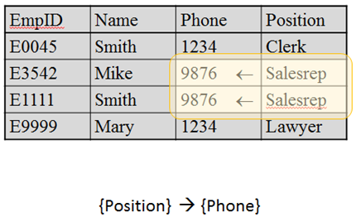
More Examples
Lecture 5 > Section 1 > Functional dependencies

Slide 39
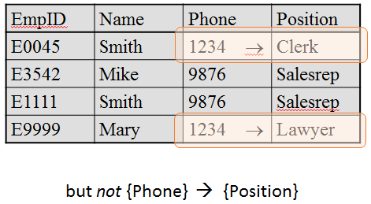
More Examples
Lecture 5 > Section 1 > Functional dependencies

Slide 40
ACTIVITY
Find at least three FDs which are violated on this instance:
A | B | C | D | E
1 | 2 | 4 | 3 | 6
3 | 2 | 5 | 1 | 8
1 | 4 | 4 | 5 | 7
1 | 2 | 4 | 3 | 6
3 | 2 | 5 | 1 | 8
{ } → { }
{ } → { }
{ } → { }
Notes:
A -> D, B→ C, C->D

